Slide 1

Visual Studio 2010 and .NET Framework 4 Training Workshop

Slide 2
Presentation Outline (hidden slide):
Technical Level: 300
Intended Audience: Developers & Architects
Objectives (what do you want the audience to take away):
How has the EDM toolset been enhanced?
How is the EF easier to use and more fully-features?
Presentation Outline:
Pluralization
Model-First
Complex Types
POCO
Lazy Loading
Foreign Keys
Model-Defined Functions
N-Tier

Slide 3

What’s New In ADO.NET Entity Framework 4
Name
Title
Organization
Email
Notes:
ESTIMATED TIME:
45-60 minutes

Slide 4
Objectives
How has the EDM toolset been enhanced?
What alternative development styles are enabled?
How is the EF easier to use?
How is it more fully-featured?
Does EF 4 address any issues you had with it?

Slide 5
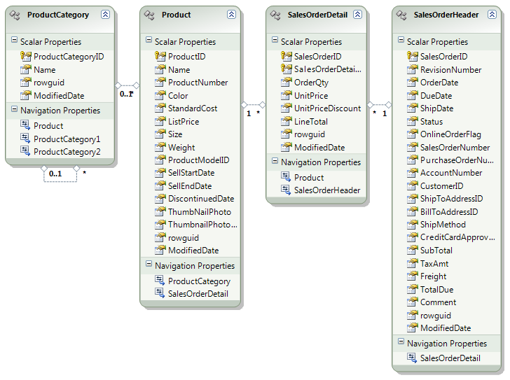





Pluralization (v1)

Slide 6
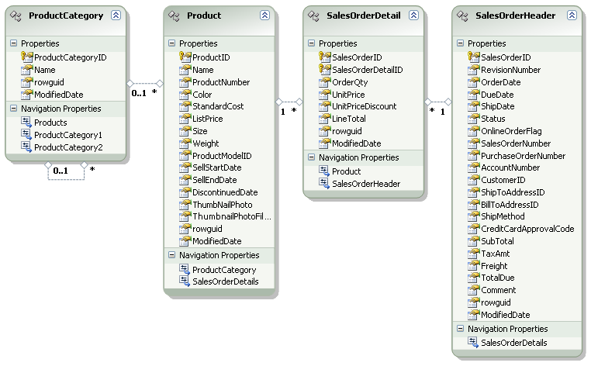




Pluralization (v4)

Slide 7
Model-First
Existing
Database
Database
First (v1)
Generated
Entity Data
Model
Generated
Database
Model
First (v4)
Entity Data
Model

Slide 8
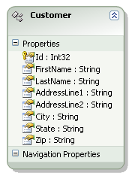
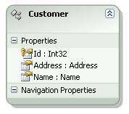
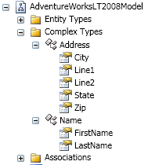
Complex Types
VS.
1:1 DB Mapping
Could get “crowded”
Flexibility from DB shape
Nicely “organized”

Slide 9


Tooling Enhancements

Slide 10
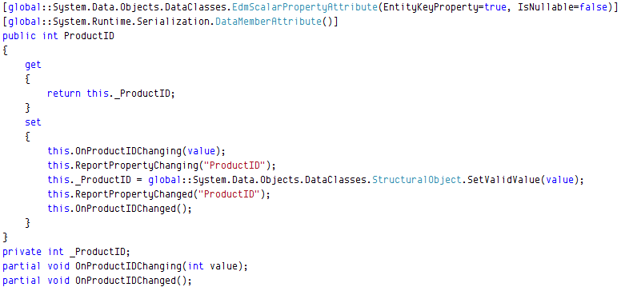
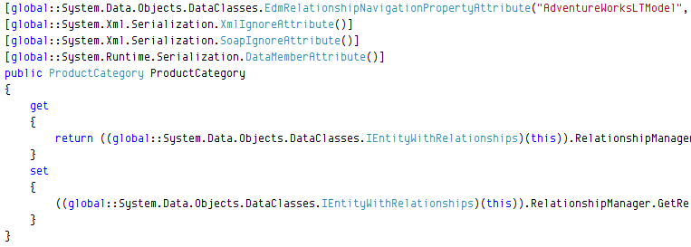
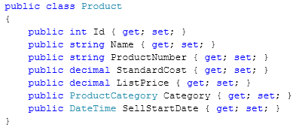

POCO
Class Definition
Everything
Navigation Property Definition
Scalar Property Definition

Slide 11
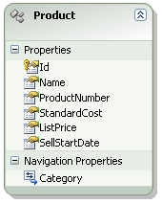
Lazy Loading
1) Get Product
Get Product
Database
2) Access
Category
Explicit
Get Category
3) Get Category
Get Product
1) Get Product
Database
2) Access
Category
Get Category
Implicit

Slide 12
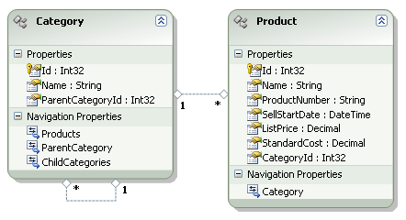
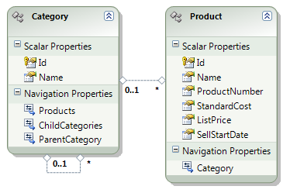
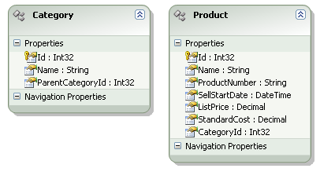
Foreign Keys
In theory this
looks really good
This is perfect!
In theory this also
looks really good

Slide 13
POCO Lazy Loading Foreign Keys

Slide 14
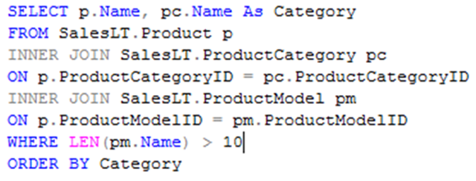
Model-Defined Functions
Entity SQL
Block
Umm, I’d rather be using LINQ…

Slide 15

N-Tier
1) Get Product
Database
Web Service
2) Update Product
2) Make
Changes
Combines power of:
DataSet
DTOs

Slide 16
Model-Defined Functions N-Tier

Slide 17
Summary
The EDM tooling has been enhanced…
Model-First
Complex Types
The EF runtime is more fully featured…
POCO
Lazy Loading
Foreign Keys
Model-Defined Functions
N-Tier

